Slide 1


MALLA REDDY ENGINEERING COLLEGE AND MANAGEMENT SCIENCES
INDUSTRY ORIENTED MAJOR PROJECT​
ON​
DISCOVERY AND PREDICTION OF STOCK INDEX PATTERN USING TPA-LSTM​
UNDER THE GUIDENCE OF​
MISS MADHAVI​
PRESENTED BY ​
BATCH – 11​
P. VINITHA(19UJ1A1239)​
M.AVANTHI(19UJ1A1228)​
M.SAI ANWESH(19UJ1A1229)​
P.BHARGAV NAIDU(19UJ1A1240)​
SAI NAGESH(19UJ1A1242)

Slide 2

DISCOVERY AND PREDICTION OF STOCK INDEX PATTERN VIA TPA-LSTM
This Photo by Unknown author is licensed under CC BY-ND.

Slide 3

CONTENTS
AIM OF THE PROJECT
ABSTRACT
INTRODUCTION
EXISTING SYSTEM
PROPOSED SYSTEM
CONCLUSION

Slide 4
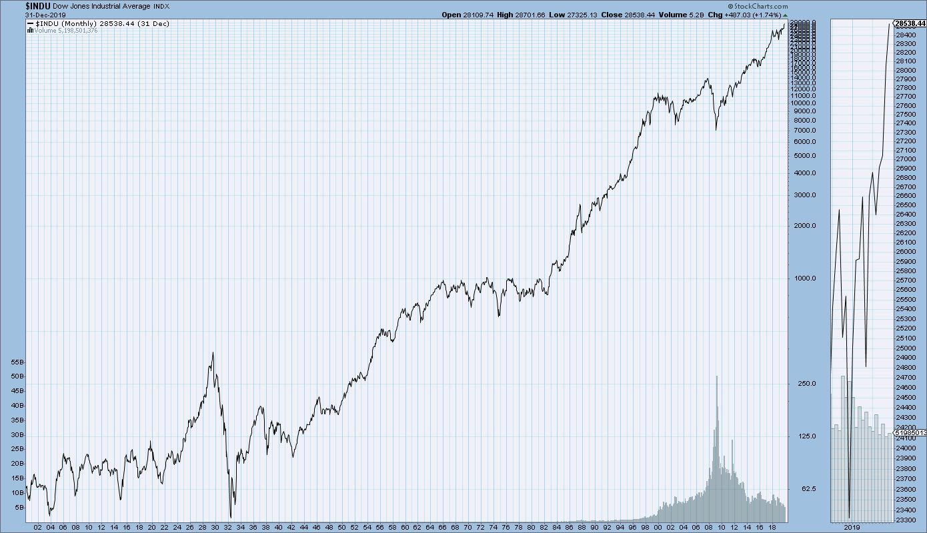
AIM OF THE PROJECT
Developing a realistic model to predict stock index for investors and professional analysts using TPS-LSTM model

Slide 5

ABSTRACT
Investors can invest passively through a stock index or compare active investment performance with stock index.
The core of the process is to find some inherent patterns in the existing stock index sequences and make appropriate prediction.
In this project, we attempt to discover and predict stock index patterns through analysis of multivariate time series.

Slide 6

INTRODUCTION
Long short-term memory (LSTM) neural networks have been proven to be effective for time series prediction, even in some instances where the data is non-stationary.
TPA-LSTM that considers weak periodic patterns and long short-term information
According to the repeated patterns which were discovered in previous work, we can predict repeated patterns of stock index over a certain period in the future.

Slide 7
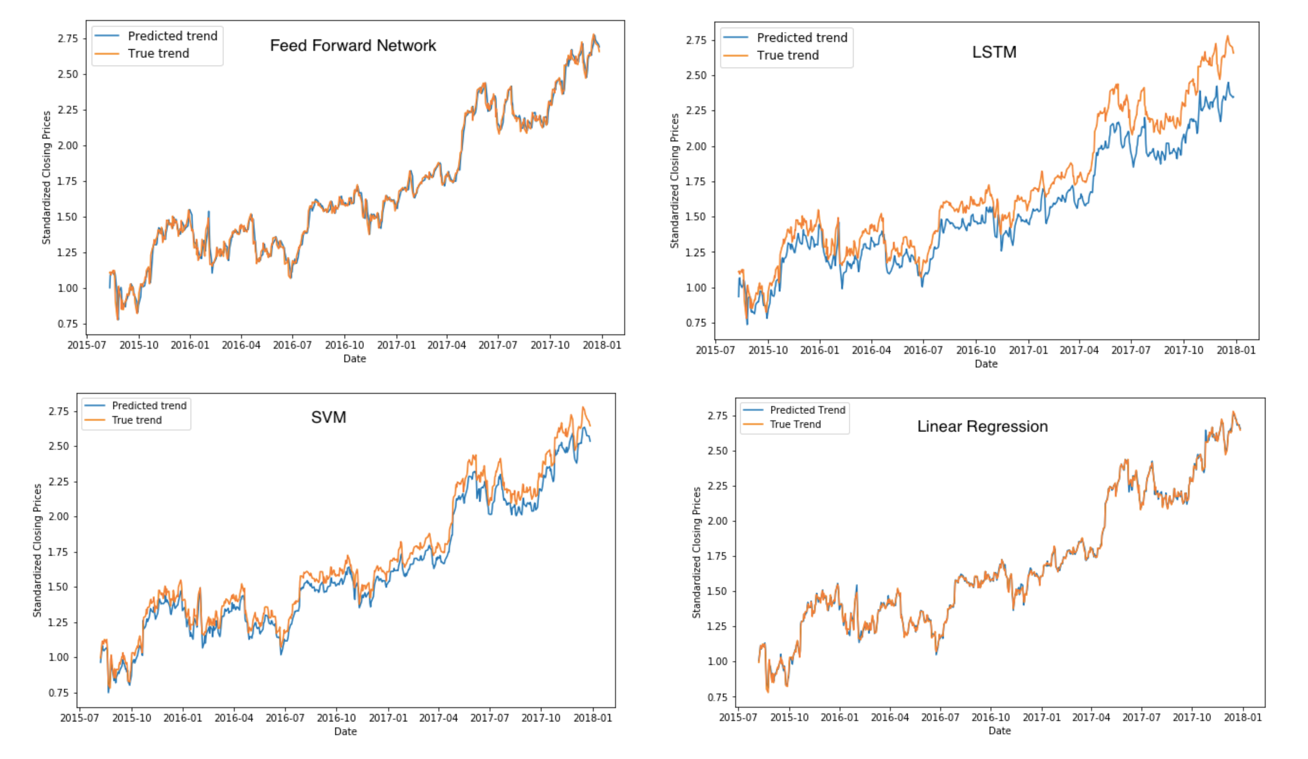
SVM MODEL
SVM is a mathematical model with solid theoretical foundation and substantially developed in pattern recognition.
.The study suggests that SVM model is preferred to predict short term and medium term, however it is not suitable for long term predictions.
Outcomes of the study indicate that the average prediction accuracy is 60.2%.

Slide 8
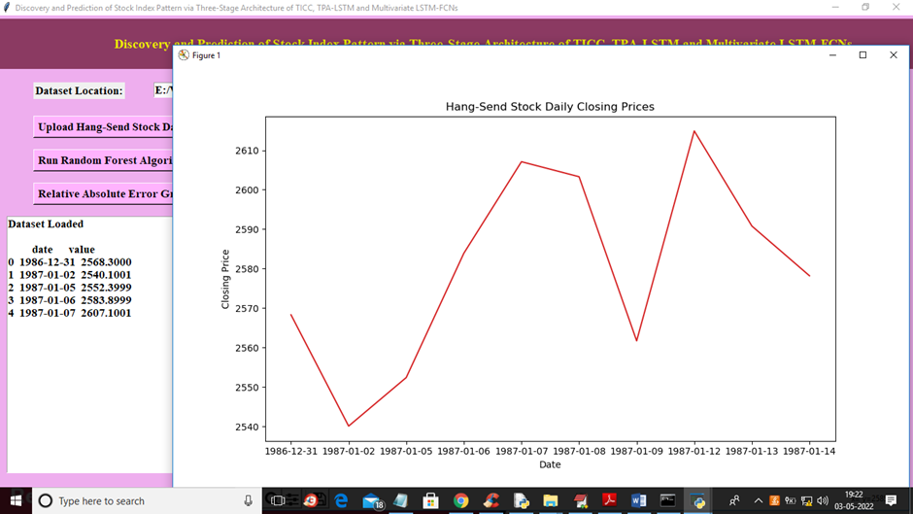
TPA-LSTM MODEL
Temporal Pattern Attention and Long-Short-Term Memory is a recurrent neural network, to analyze time series data and make predictions.
Collects the historical stock index data and use it make predictions on future stock index values.
Accuracy achieved using TPA-LSTM model is 87%.

Slide 9
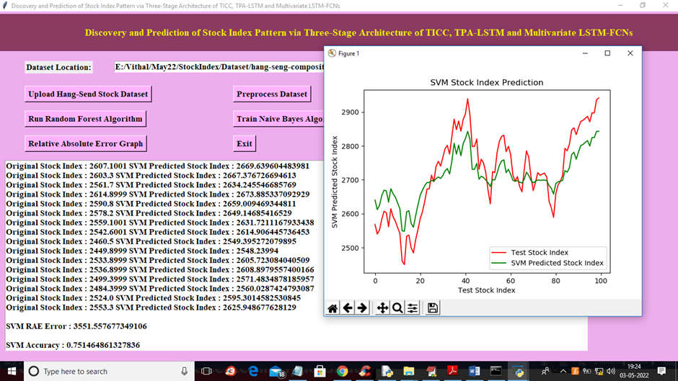
TPA- LSTM MODEL
The TPA-LSTM architecture includes three main components: the LSTM layer, the attention layer, and the fully connected layer.
The LSTM layer, the attention layer, and the fully connected layer.
The LSTM layer is responsible for processing the temporal sequence of input data and generating hidden states.
The attention layer calculates attention weights for each hidden state based on the importance of the corresponding input feature.

Slide 10

CONCLUSION
TPA-LSTM method is a new prediction model that enables the prediction of multivariate time series data.
TPA-LSTM model make appropriate actions to take gains and avoid losses more effectively.

Slide 11
REFERENCES
Y. S. Abu-Mostafa and A. F. Atiya, “Introduction to financial forecasting,” Applied Intelligence, vol. 6, no. 3, pp. 205–213, 1996.
View at: Publisher Site | Google Scholar
C. Huang and J. Cao, “Active control strategy for synchronization and anti-synchronization of a fractional chaotic financial system,” Physica A: Statistical Mechanics and its Applications, vol. 473, pp. 262–275, 2017.
View at: Publisher Site | Google Scholar
J. Zhang, Y.-F. Teng, and W. Chen, “Support vector regression with modified firefly algorithm for stock price forecasting,” Applied Intelligence, vol. 49, no. 5, pp. 1658–1674, 2019.
View at: Publisher Site | Google Scholar.

Slide 12


